Slide 1
Computer Science
Mr. Eddie

Slide 2
Agenda

Slide 3

Agenda
Do Now
What is a web developer
Client-Server Model
Front-End Vs. Back-End
Websites and Webpages
Activity #1
Activity #2
Exit Ticket

Slide 4
Do Now
Answer the following questions:
What’s a website you often use, and why?
What do you like about this website.
What’s an application you use on your phone. Is that application available for other devices (computers, smartTV, tablets etc…)

Slide 5
Unit 1
Using Online Search Tools to Locate & Evaluate Information Pt. 2

Slide 6
Objectives
describe various job opportunities, and the role information technology plays in these fields.
show knowledge of the education level, certification, and skills related to careers they are interested in.

Slide 7
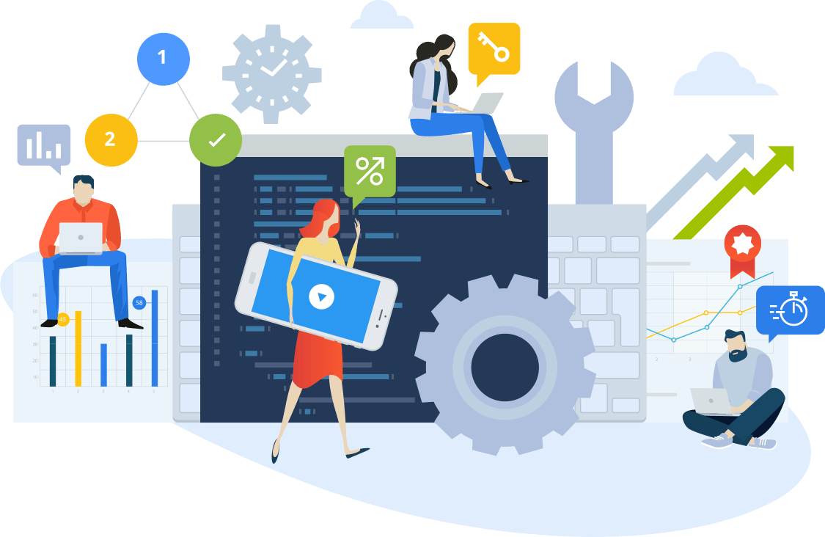
What Is a Web Developer
A web developer is a programmer who specializes in, or is specifically engaged in the development of World Wide Web applications using a client–server model.

Slide 8

Client-Server Model
Client–server model is a distributed application structure that partitions tasks or workloads between the providers of a resource or service, called servers, and service requesters, called clients.

Slide 9
Agenda
Do Now
What is a web developer
Client-Server Model
Front-End Vs. Back-End
Websites and Webpages
Activity #1
Activity #2
Exit Ticket

Slide 10
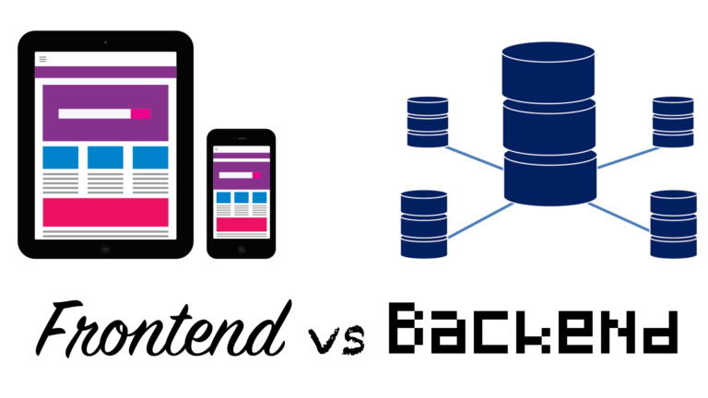
Full-Stack Web Developers

Slide 11
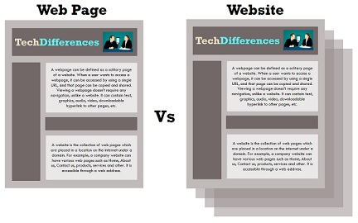
Is a website a webpage?

Slide 12
Activity #1 - Job Search

Slide 13
Job Search
No. | Company | Job Title | Requirements
1
2
3
4
5

Slide 14
Agenda
Do Now
What is a web developer
Client-Server Model
Front-End Vs. Back-End
Websites and Webpages
Activity #1
Activity #2
Exit Ticket

Slide 15
Activity #2 - Comparisons

Slide 16
Front-End Developer
Back-End Developer

Slide 17
Exit Ticket

